Slide 1
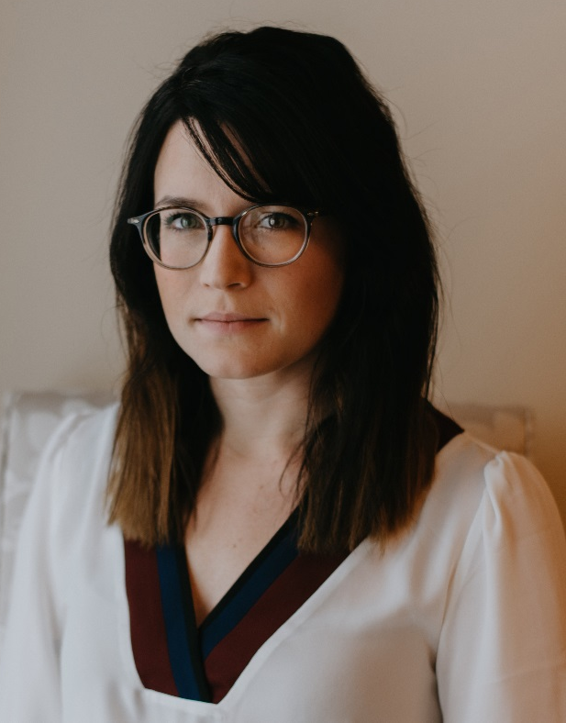
Dissertation Announcement
A dissertation submitted in partial fulfillment of the requirements for the degree of Doctor of Philosophy Microbiology and Immunology
The University of Michigan 2020
"Investigating the Contribution of Iron Acquisition to Serratia marcescens Pathogenesis during Bacteremia"
Presented by
Danelle Weakland PhD Candidate Microbiology and Immunology
Friday, October 16, 2020
10:30 am
https://umich-health.zoom.us/j/97901642629

